Slide 1

Northeast Valley Bookstore “Home to Infinite Knowledge”
Team: Avengers
Arundhati - 002780632
Santosh -002798165 Sathwik – 002873268
Sourabh - 002820396

Slide 2
Project Statement
The Northeast Valley Bookstore project is aimed at managing books, Members, and transactions in a public bookstore setting.
The purpose of the project is to provide a user-friendly and efficient way for members and staff to search for books, issue and return them and manage transactions.
This system will significantly streamline the bookstore's operations, enhancing customer experience and overall efficiency.

Slide 3
Topics Covered
Inheritance
Interface
Abstraction
Polymorphism
Lists
Stacks
Exception Handling
Lambdas
Encapsulation

Slide 4
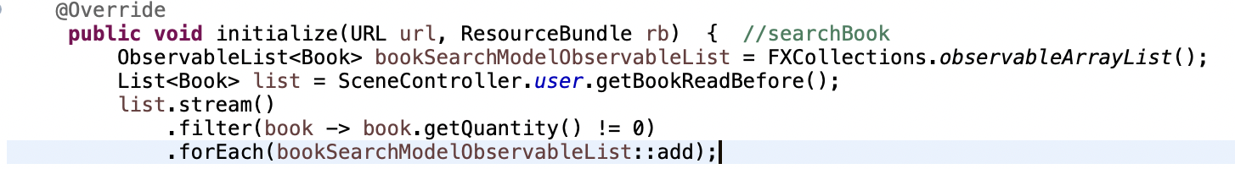
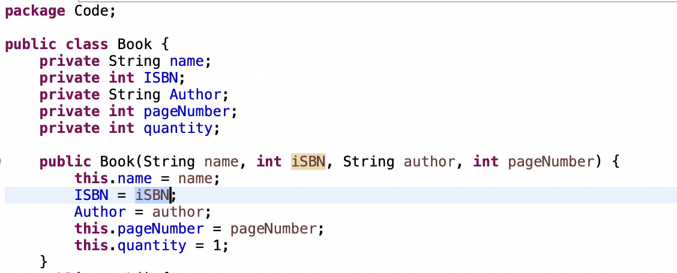
Encapsulation
Lambdas

Slide 5
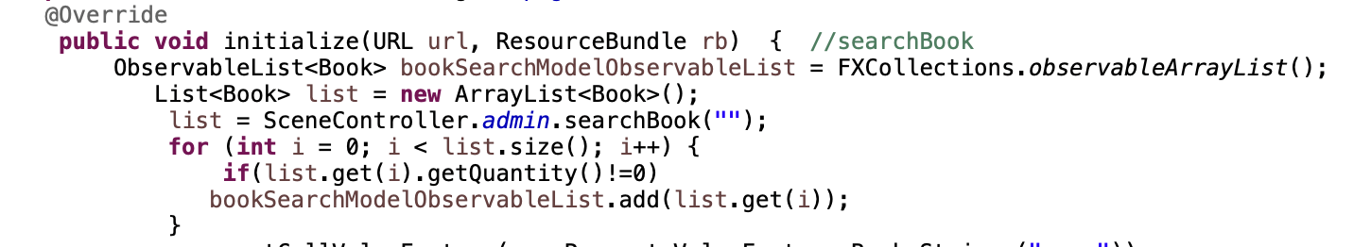
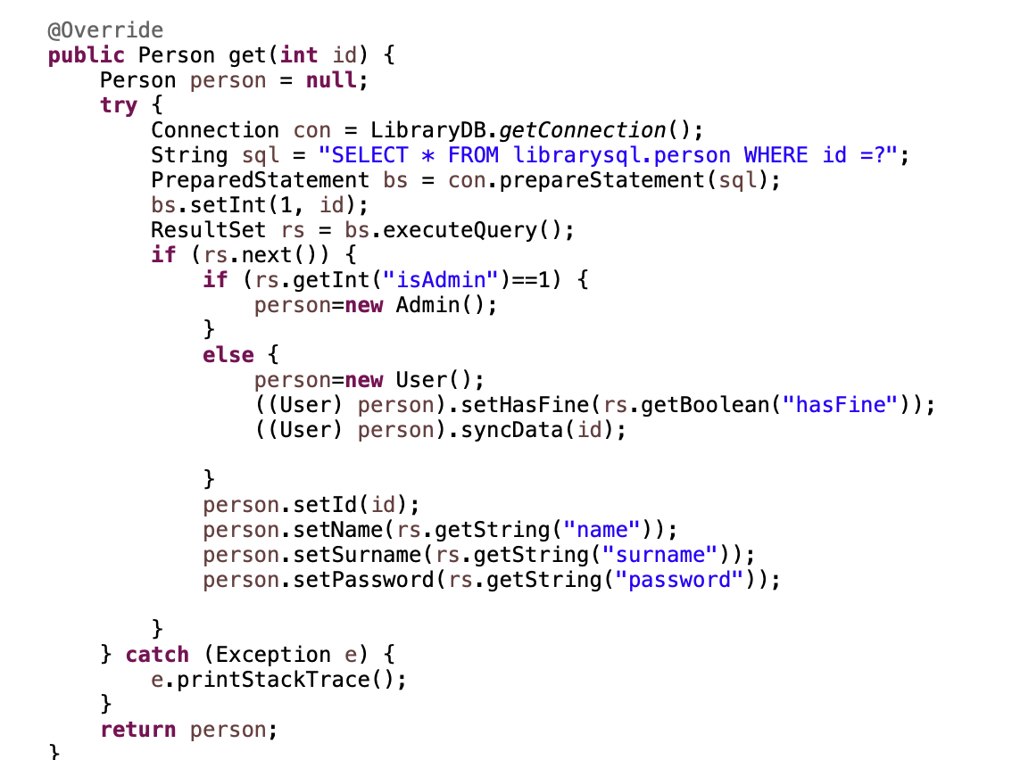
Exception Handling
Polymorphism

Slide 6





Tools Used
This Photo by Unknown Author is licensed under CC BY-NC

Slide 7

Analysis
Developed project using eclipse with MVC architecture
Multiple user logins : 1) Admin 2) User
Functional Requirements: 1) Allow user and Admin to Login 2) Support and contact 3) Admin: Add, Delete, Search, Give, Return, Fine 4) User: View Read Books, Search, Profile Info
Non-Functional Requirements: 1) Performance 2) Security 3) Quality

Slide 8
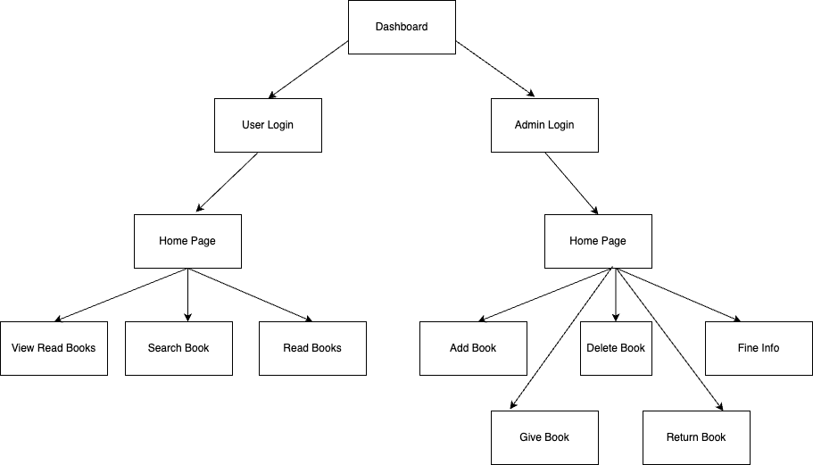
System Diagram

Slide 9
Systems Architecture
Person
Book
Admin
User
Login.fxml
Dashboard.fxml
Homescreen.fxml
Model
View
SceneController
LoginController
CurrentBooks
Controller

Slide 10
Database and Schema
Two tables:
Person: id (PRIMARY KEY), name, surname, password, isAdmin, hasFine, BookReceived, BookReadBefore, deadline
Book: ISBN (PRIMARY KEY), name, author, pageNumber, quantity
Created Database class which uses JDBC driver to connect to the database and to perform CRUD operations

Slide 11
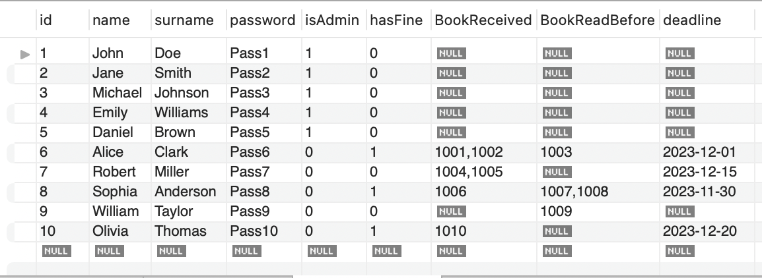
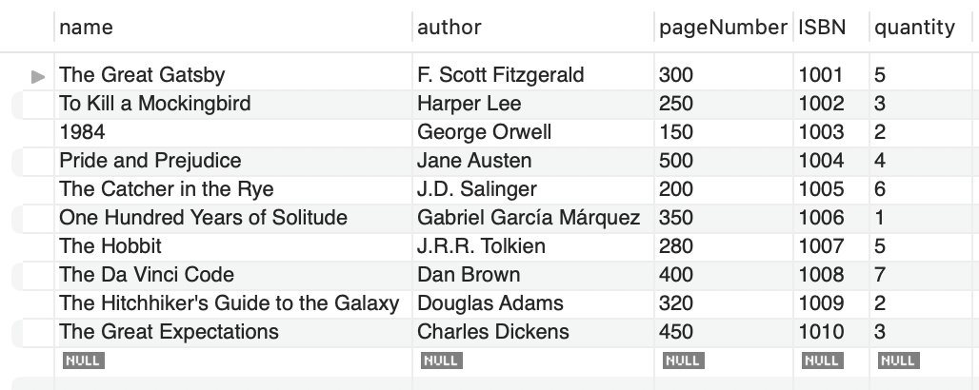
Database Schema sample
Person
Book

Slide 12
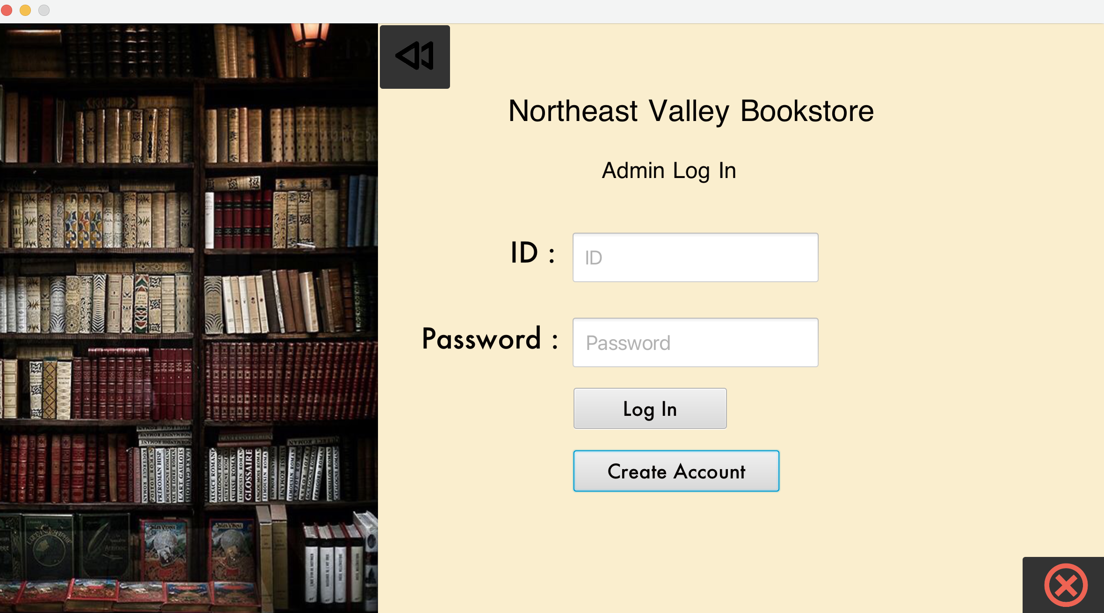
Implementation
Admin
1. Login : Admin can login to their account using the admin credentials
2. Admins credentials are fetched from the database and is validated.

Slide 13
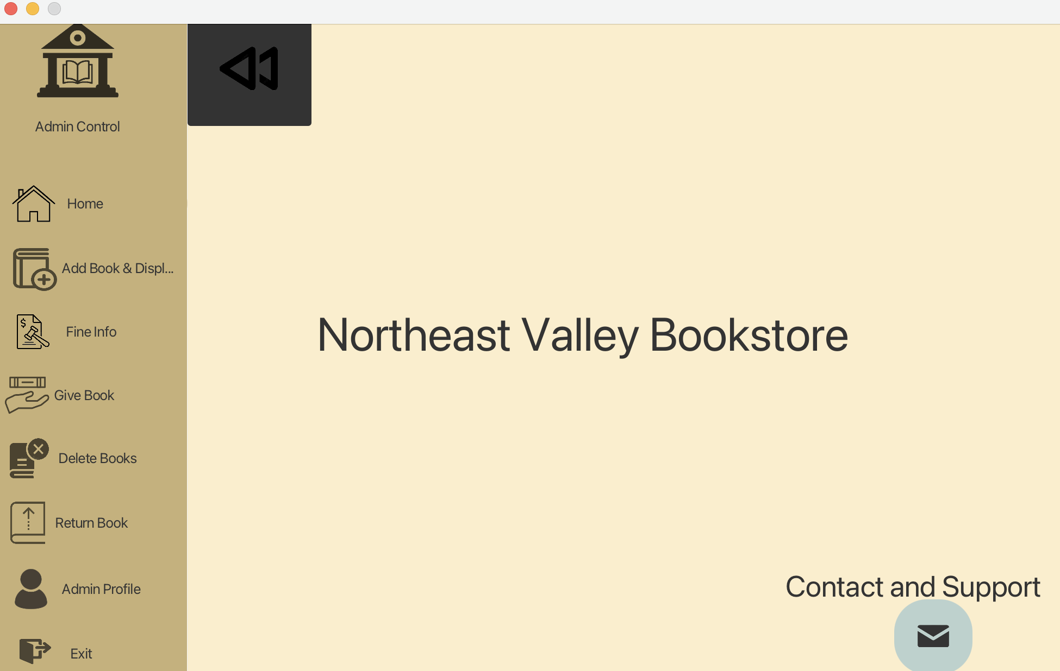
Implementation
Admin
3. Contact Support for Help
4. View Home Page

Slide 14
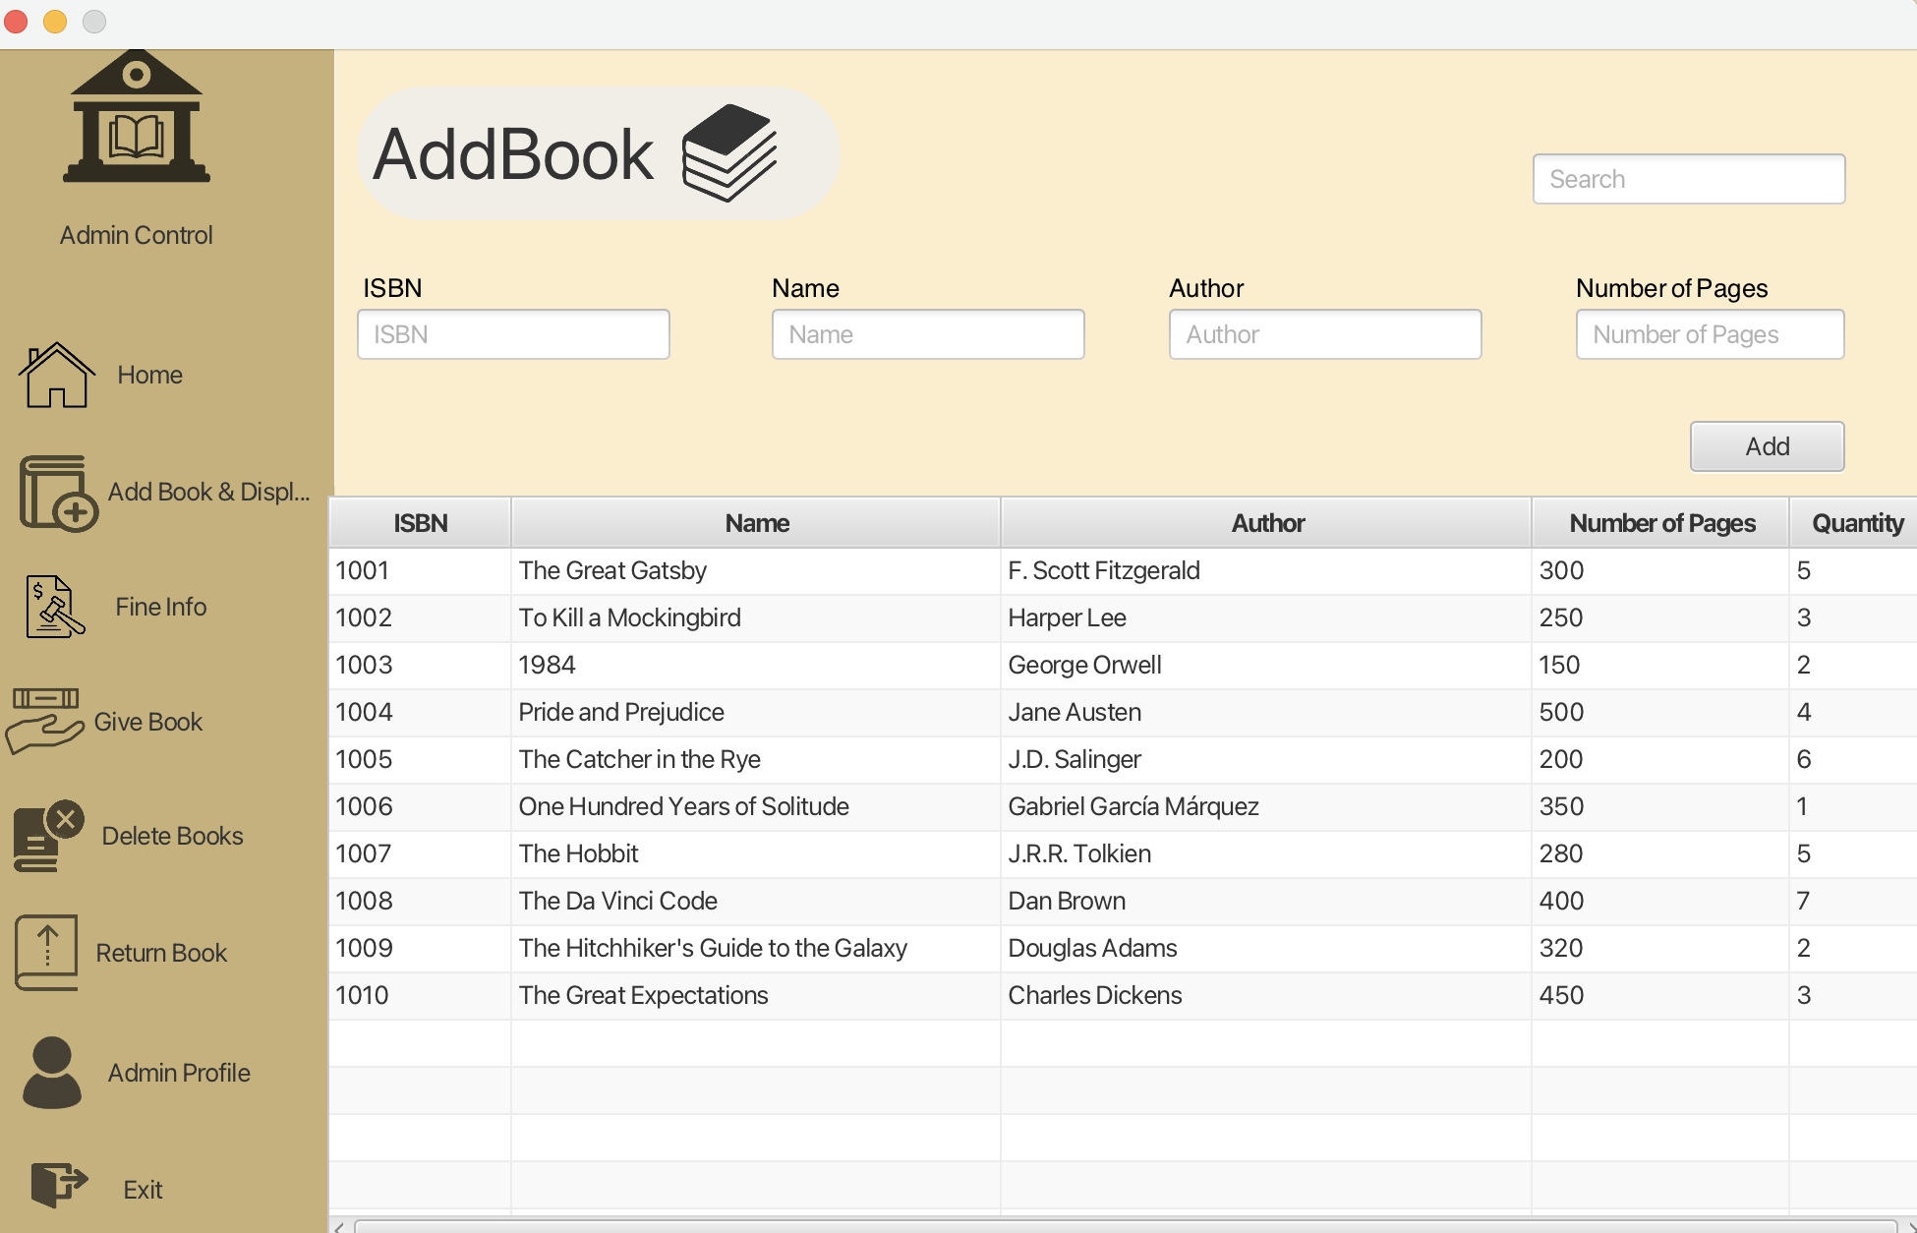
Implementation
Admin
5. Add Book

Slide 15
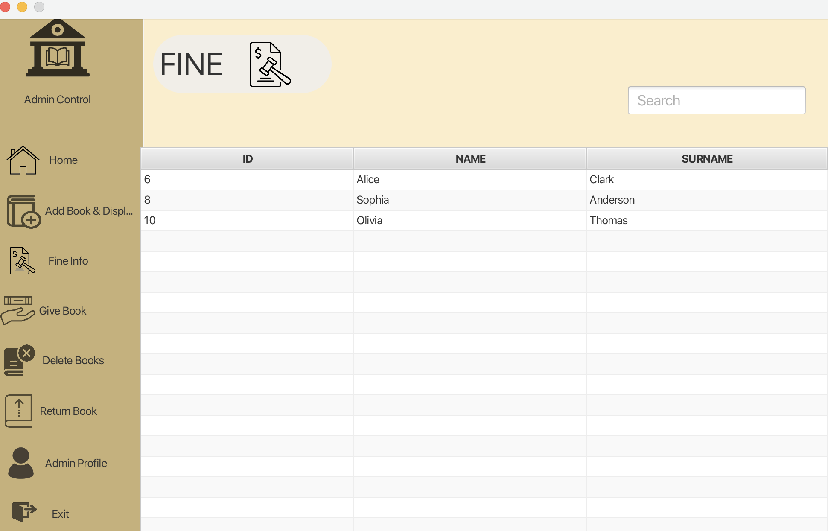
Implementation
Admin
6. View Fine Info

Slide 16
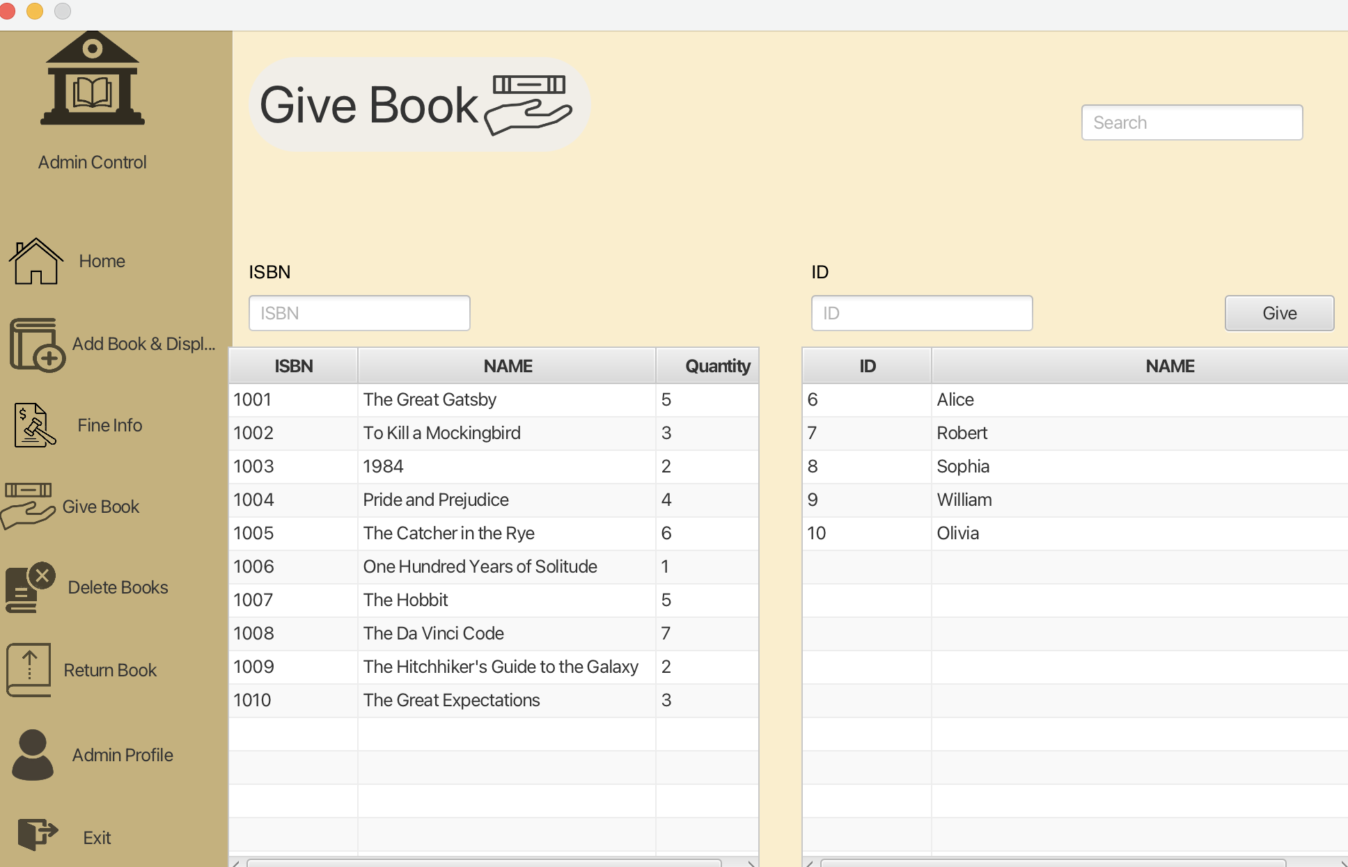
Implementation
Admin
7. Give Book

Slide 17
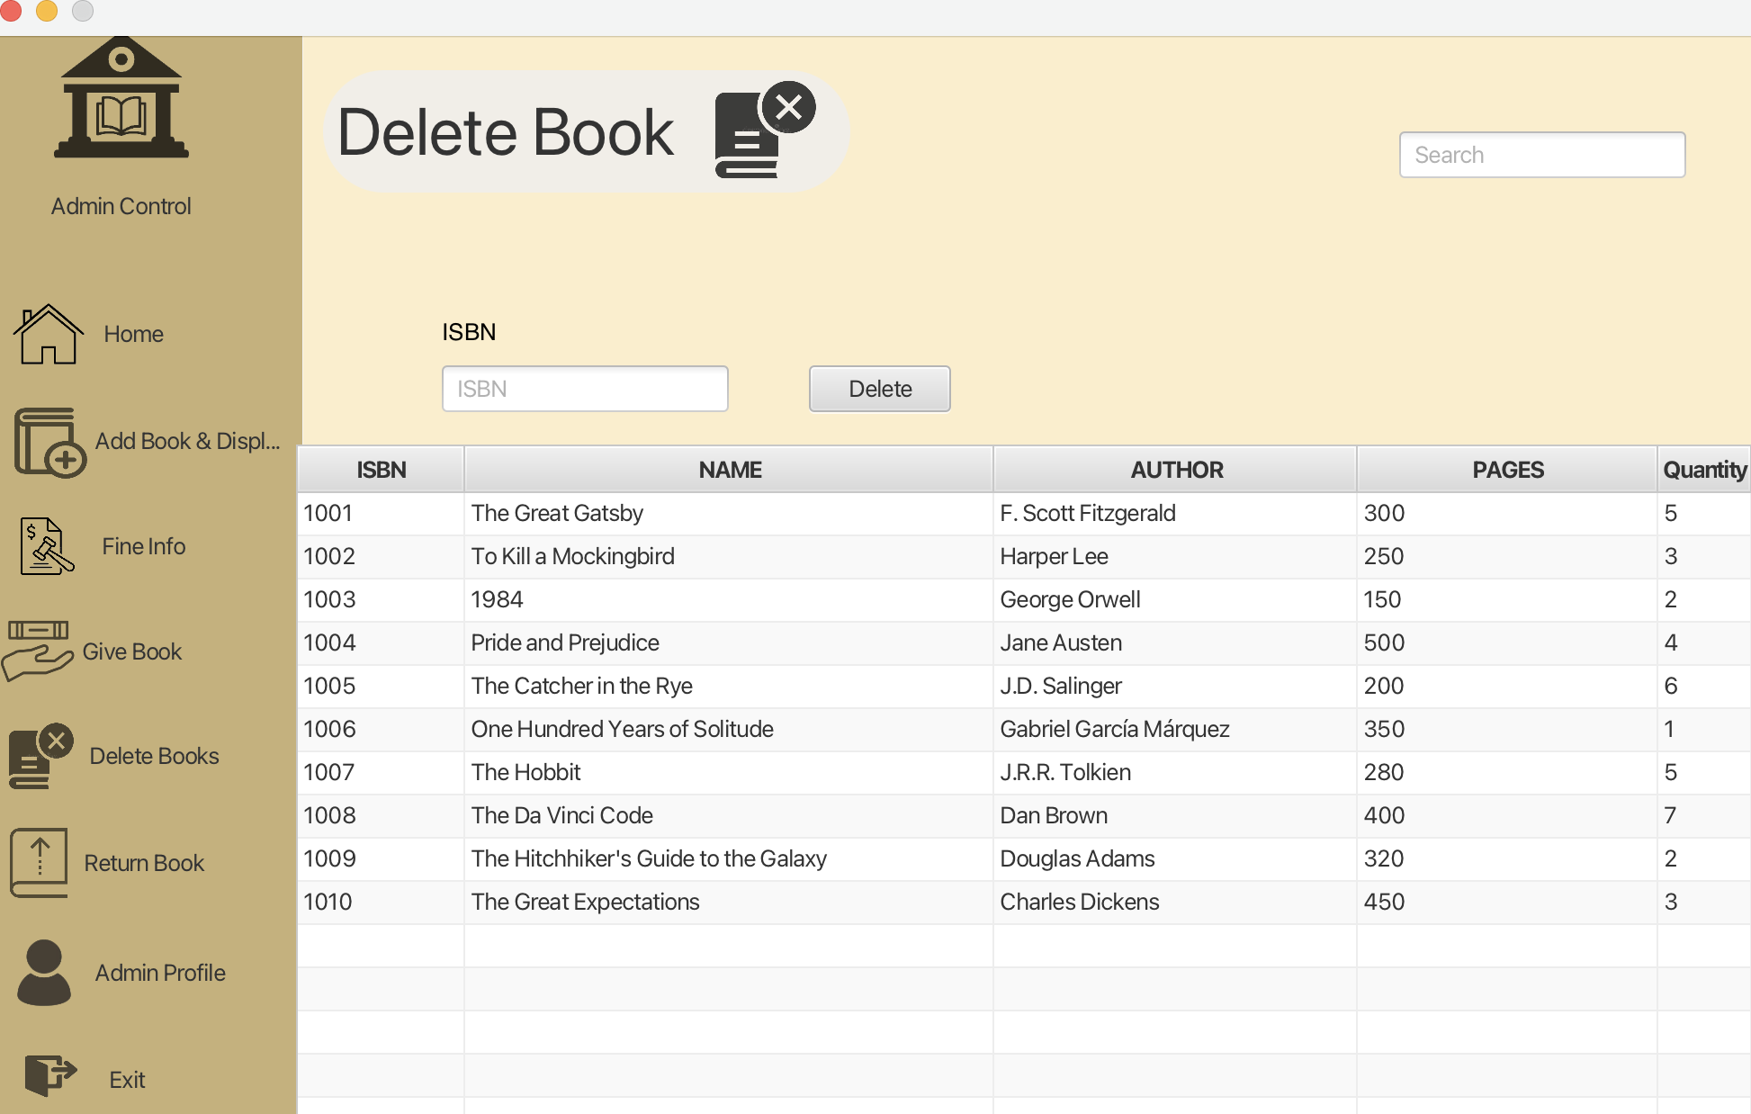
Implementation
Admin
8. Delete Book

Slide 18
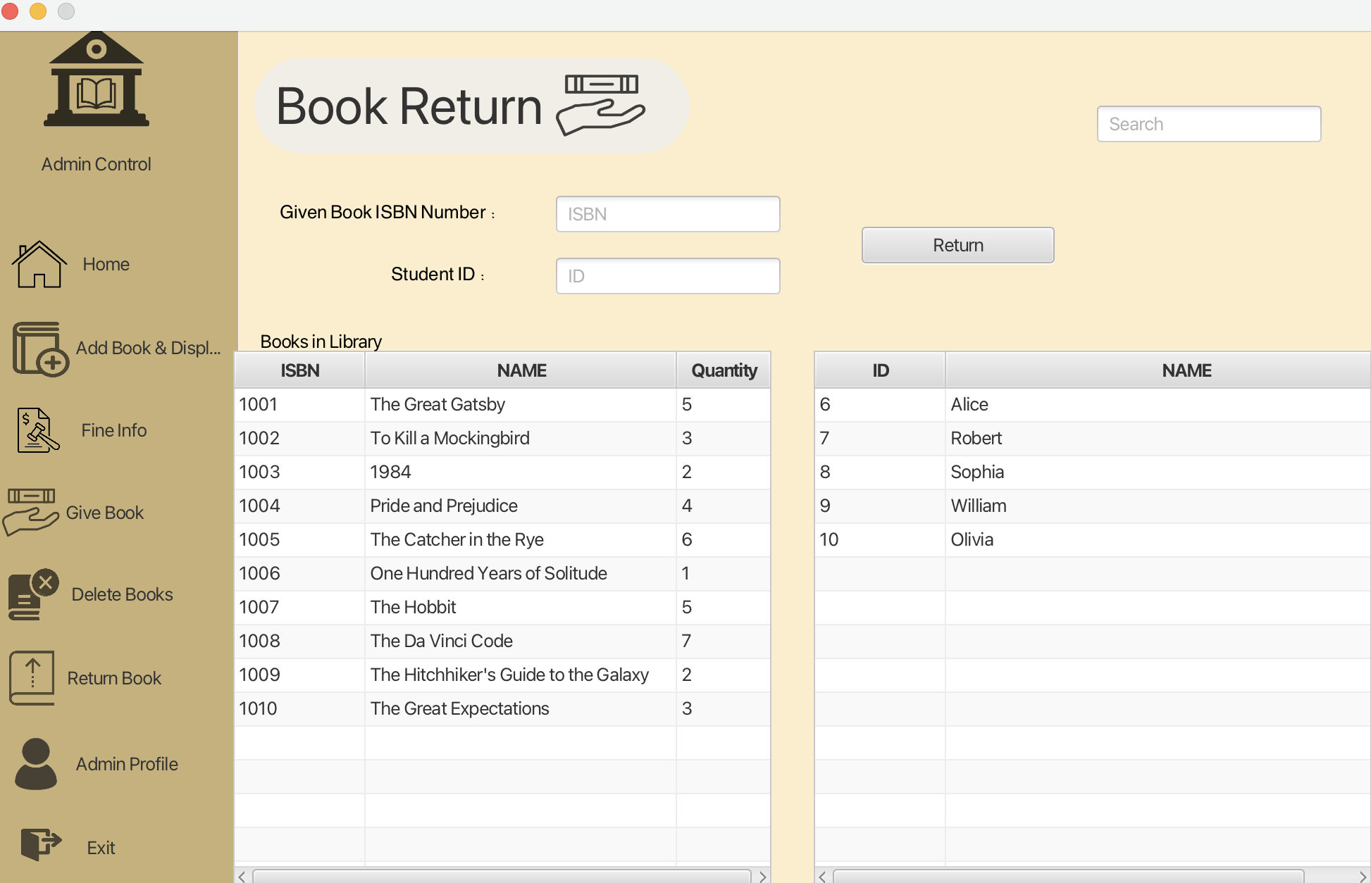
Implementation
Admin
9. Return Book

Slide 19
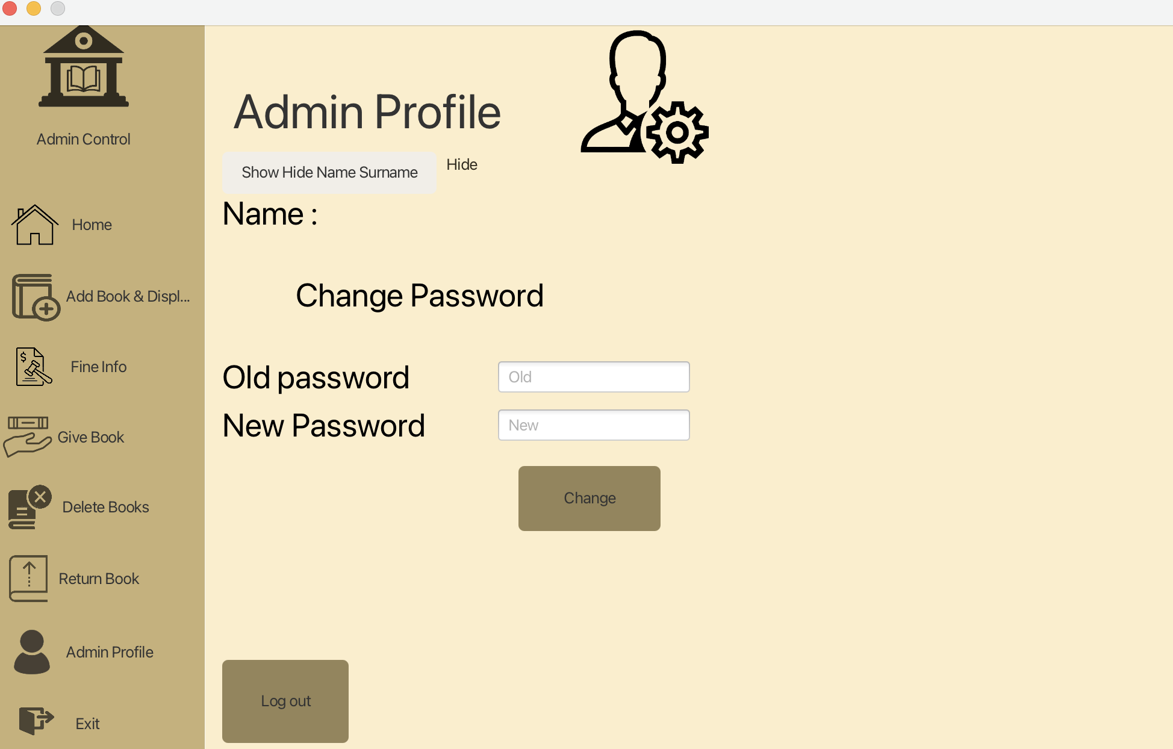
Implementation
Admin
10. View Admin Profile
11. Change Password
12. Logout/Login

Slide 20

Implementation
User
Can login with the username and password
Can view the available books and check their fines and deadlines

Slide 21
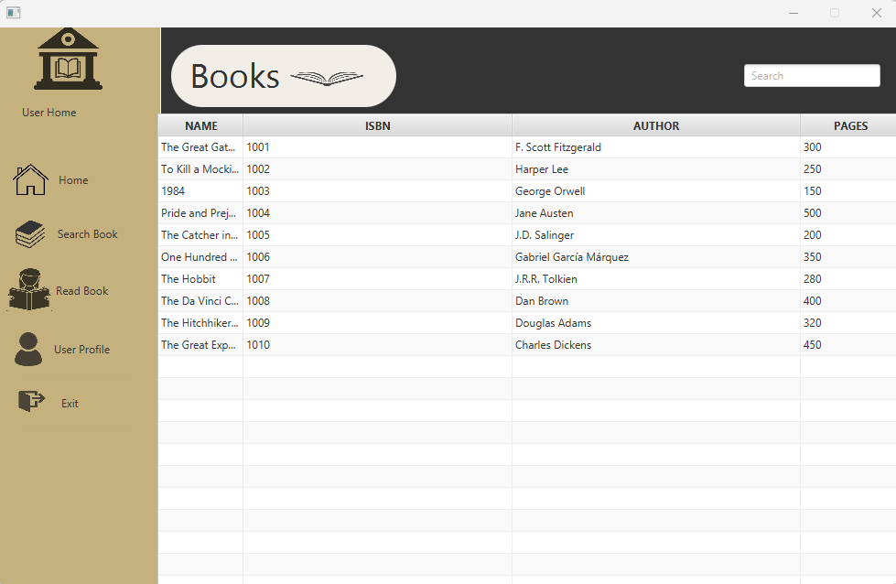
Implementation
User
3. Can Search any books that are available in the store

Slide 22
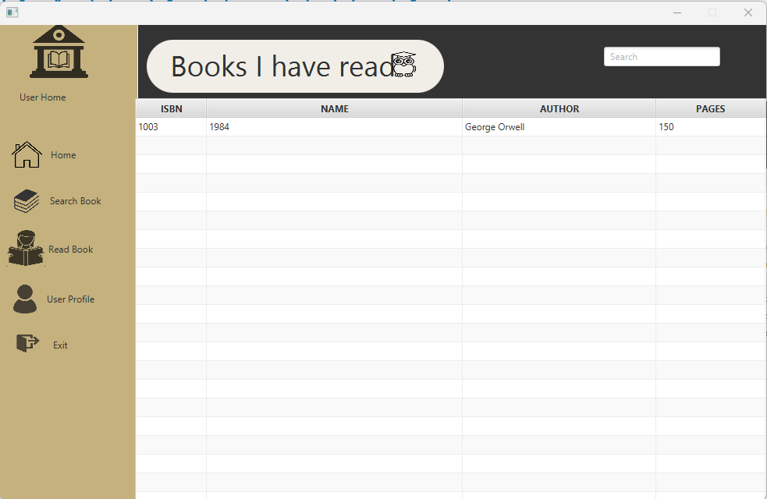
Implementation
User
4. Users can see which books they have already read once they return

Slide 23
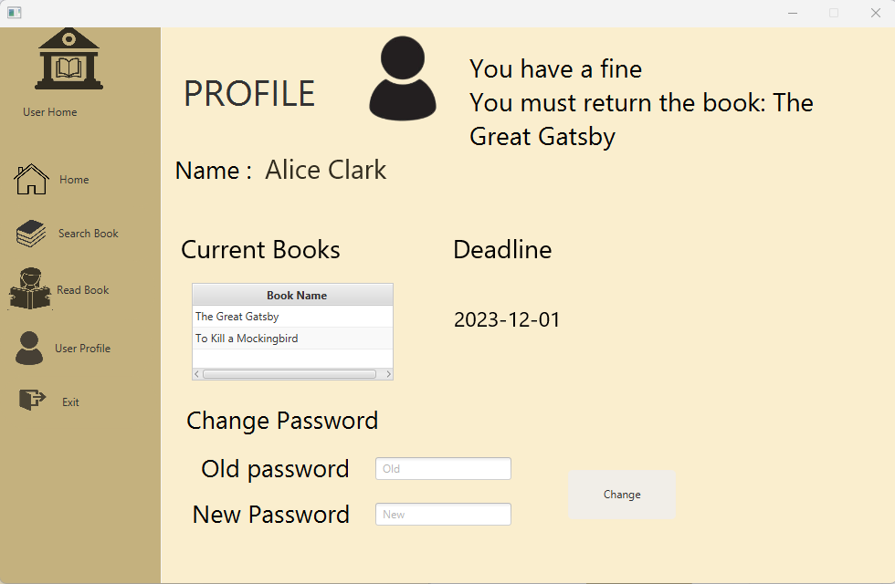
Implementation
User
5. User can check their fines and deadlines
6. Users can also change their password

Slide 24
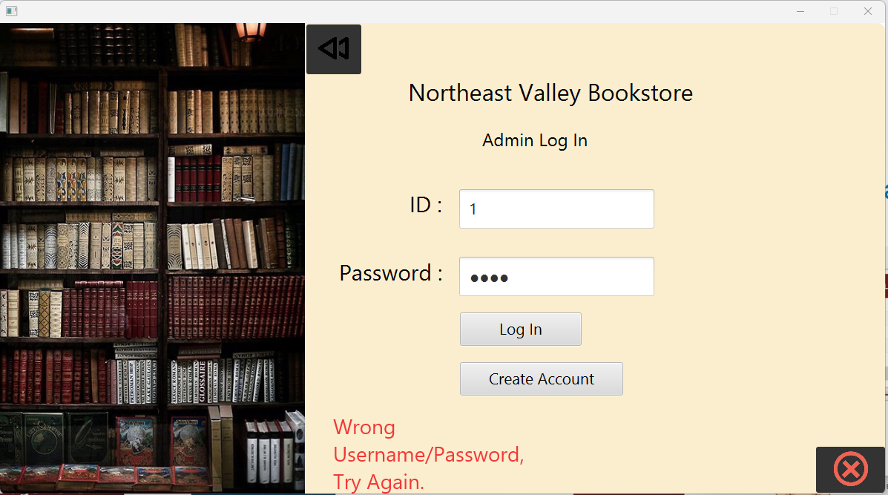
Validations
Login validation
Can't issue book to users with fine

Slide 25
Evaluation
Developed database integration skills and gained comprehensive understanding of the workflow from front-end to back-end.
Acquired practical knowledge in storing and retrieving user information from databases while applying various Object-Oriented Programming (OOP) concepts taught in class and assignments.
Enhanced utilization of OOP principles and Collections, including lists and sets.
Additionally, familiarized with JavaFX Observable List and its application within collections.

Slide 26
Problems Encountered
Found difficulty in choosing the proper database for our project.
We have never connected any Java application with MySQL in the past, so it was difficult in the beginning to bind the Database with the application.
Handling exceptions to prevent application breakdown

Slide 27
Future Scope
The Bookstore application can be enhanced to include a few other feature such as book recommendation for users based on reading history.
Email notifications can be sent when there are updates made to the user profile like when a book is returned or issued
An explore page for users could also be implemented for them to see the latest releases and interesting things about the bookstore.
A feature can be added where a user can read initial 5-10 pages of the eBook before issuing the physical copy.

Slide 28
Conclusion
Upon project completion, we determined that employing the MVC architecture enables efficient construction of the project's back-end.
Throughout the project, we gained insight into the significance of JavaFX and its capability in developing sophisticated applications.
Furthermore, we leveraged object-oriented principles such as inheritance, abstraction, polymorphism, interfaces, and generics to enhance the efficiency of the application's code.

Slide 29
Contributions
Arundhati: System design for the admin module, admin scene controller logic, UI development for the admin homepage, fine, add book, and give book sections, as well as admin exception handling.
Santosh: System design for the user module, user screen controller logic, UI development for the user homepage, search book section, user profile, and read book section, along with CRUD operations and user exception handling.
Sathwik: Admin controller logic for advanced functionality, database design and connections, UI development for the admin delete book and return book sections, and password authentication.
Sourabh: UI development for the admin profile page, unit testing for the admin module, UAT for both admin and user modules, and email integration.

Slide 30

THANK YOU

